Slide 1
MISSION UPDATES
May 2026

Slide 2
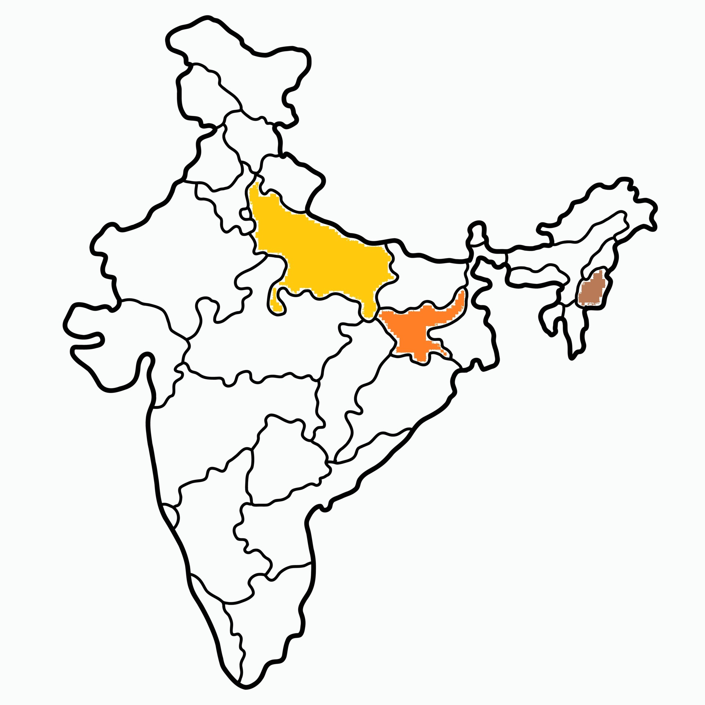

Slide 3
Mission Stations
10 mission stations supported in Jharkhand – Khunti Dist.
5 mission stations supported in U.P. – Balia(2) and Varanasi dist . (3)
1 ICPF workstation supported in North-east India (Dimapur).

Slide 4
NORTH INDIA MISSION
UP
5 Stations - ₹3000 each
Balia and Varanasi
Jharkhand
10 Stations - ₹3000 each
Khunti District
ICPF
1 Station - ₹5000
Dimapur

Slide 5
JHARKHAND

Slide 6
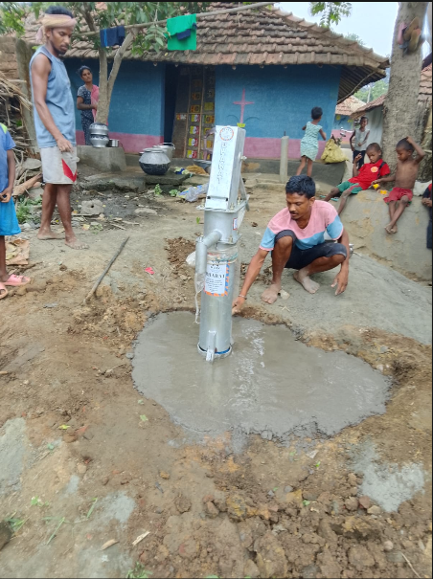
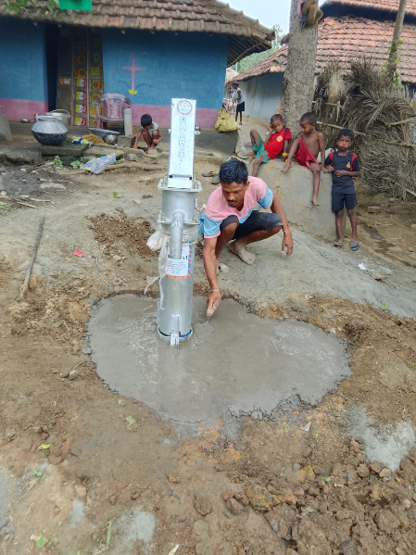
Borewell sponsored at Chuchi, Sahibganj

Slide 7
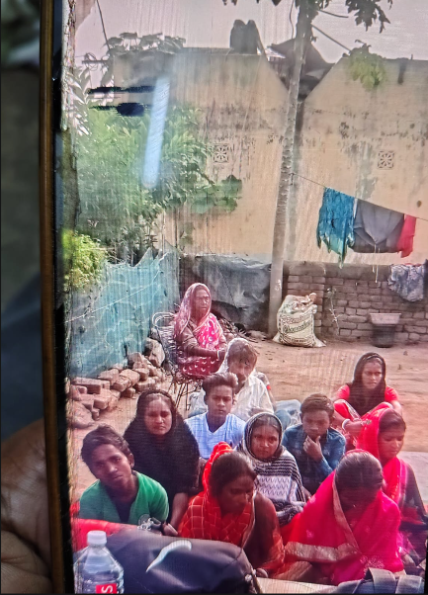
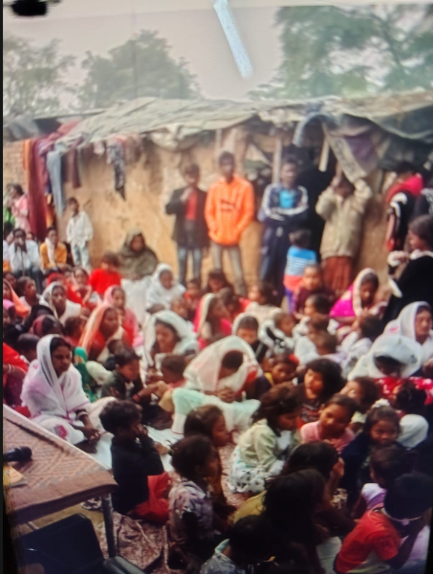
Slum Ministry,Bokaro

Slide 8
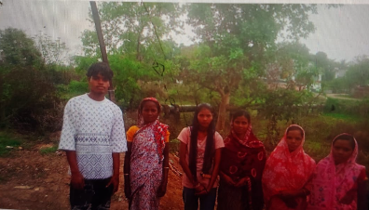
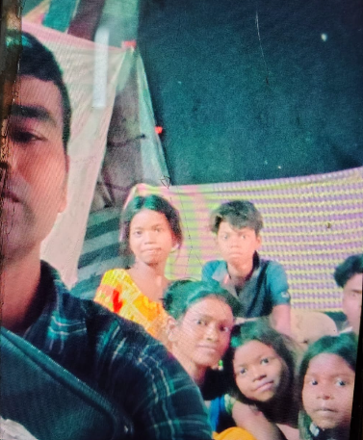

Slide 9
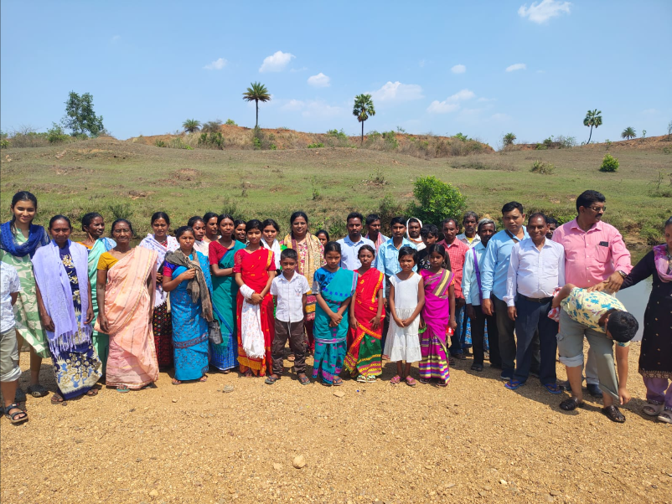

Slide 10
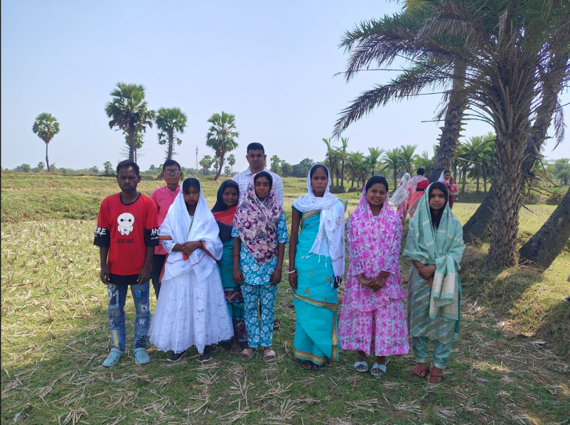
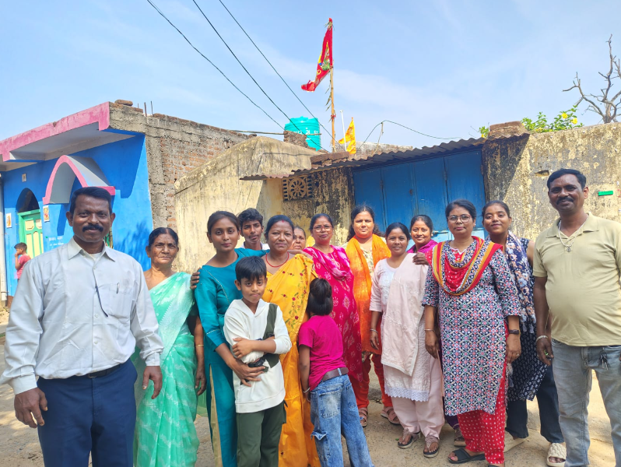

Slide 11
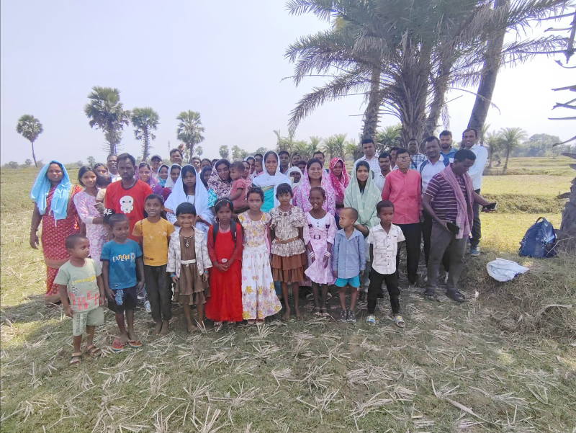

Slide 12
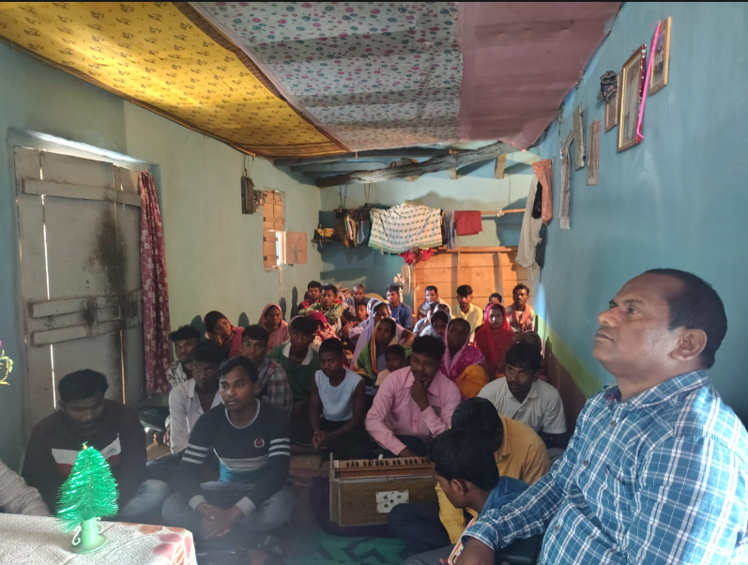

Slide 13
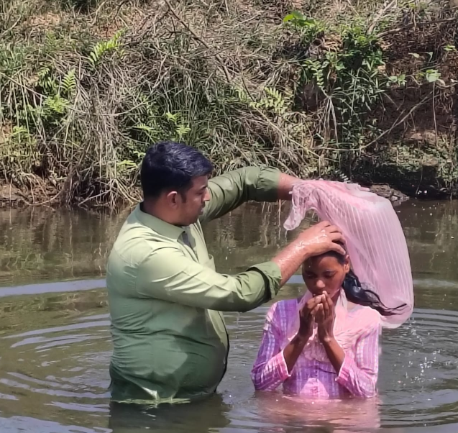
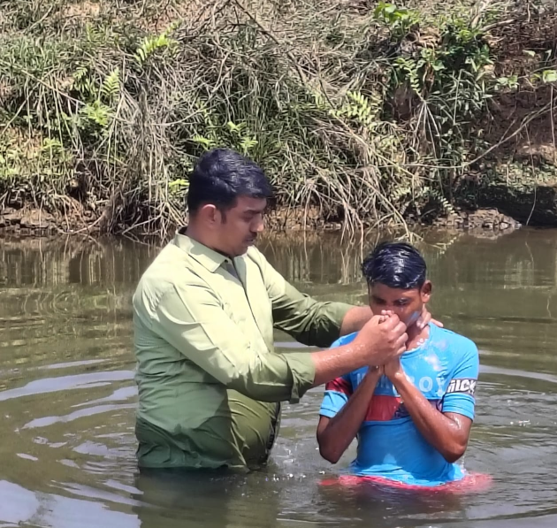
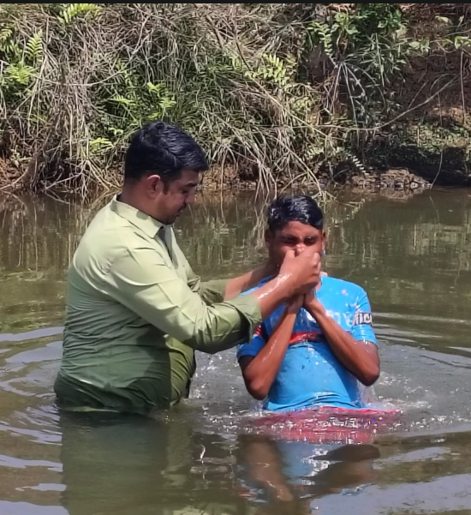
Baptisms

Slide 14
UTTAR PRADESH

Slide 15
Pray for the VBS to be conducted.
Pray for Pr. Sunny George,undergoing treatment at Kottayam.

Slide 16
NAGALAND(North-East)

Slide 17
ICPF MISSION STATION- DIMAPUR
Staff worker: Priscilla Ngullie
MINISTRY RESULTS
APR 2025 TO MAY 2026
Category | Count
Accepted Christ | 5
Decision for Water Baptisms | 4
Baptisms | 3
Holy Spirit Baptisms | 3
Ministry Commitments | 9
Personal Evangelism | 61
House Visits | 76
CGPF | 12
Counselling & Mentoring | 12

Slide 18
Thank You

